Slide 1
Johnson Creek Volunteer Parks Naturalists Orientation
2018

Slide 2
Agenda for tonight
6:00-6:30 Welcome, introductions, order food, hand out paperwork
6:20-6:30 Green Streets Program Orientation
6:30-7:30 Volunteer Parks Naturalist Program Powerpoint Orientation
7:30-8:00 Natural Area Sign-up, wrap up, hand in paperwork.
Final questions and goodnight!

Slide 3
Who we are: Johnson Creek Watershed Council
Our mission is to promote restoration and stewardship of a healthy Johnson Creek Watershed through sound science and community engagement.
Notes:
Johnson Creek Watershed Council welcomes ALL people that live, work, and play around Johnson Creek.
JCWC was formed in 1995- we are going to be 23 in May!
26 miles
Grassroots group working for change
Work with lots of partners- PP&R, BES, COG, EMSWCD, FO groups, FOT, Green Lents, APANO, AYCO, WOTE, many more

Slide 4
Q: What’s a watershed council?
Notes:
Who can guess how many watersheds are in the Portland area?
In 1995 OR legislature passed a bill providing guidance on establishing watershed councils-
-this decision is made by local gov’ts (no state approval required)
-locally organized, voluntary, nonregulatory to improve conditions of watersheds and represent interests of the basin.

Slide 5
Q: What’s a watershed?
Notes:
If you’re standing on it, it’s part of the watershed.

Slide 6
Our watershed
Notes:
175k residents in clack and mult co.
26 miles long, 54 sq miles
5 jurisdictions
Historically forested wetland
ISSUES: Urbanized stream-unique challenges of ag, industry, residences→ pollutants, high temps, floodplain connectivity
Lower 13 miles has been lined with rock to control flooding-without success

Slide 7
How do we fit in?

Slide 8
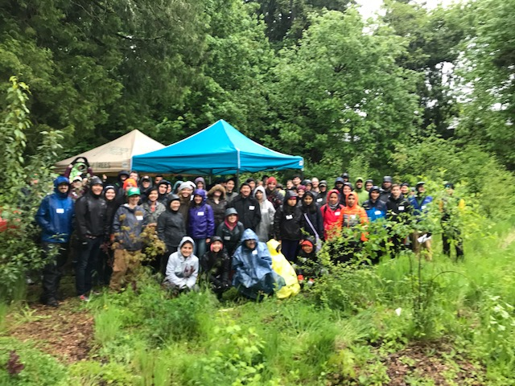
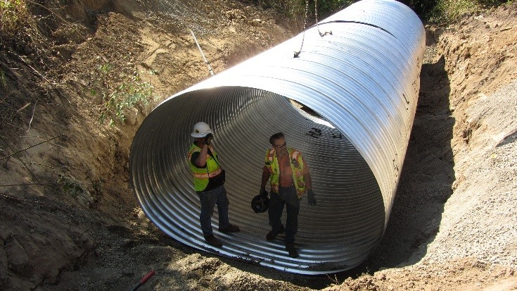
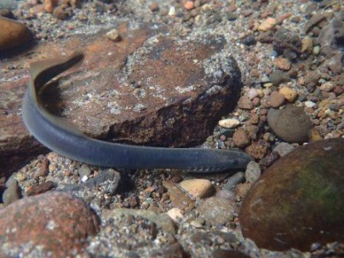
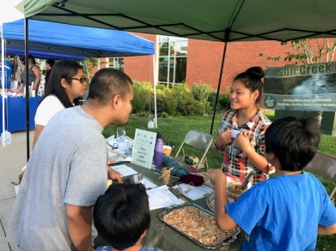
Overview of JCWC Programs
Volunteer Program
Community Science
Restoration
Creek Crew
Parks Naturalists!
Interns
Outreach Task Force
Riparian Program
Restoration Program

Slide 9
Who we are: Portland Parks & Recreation
Land Stewardship Natural Areas East: Preserve, protect, and restore Portland’s natural resources to provide equitable access to nature in the city.
PP&R welcomes people of all ages, races, religions, ethnic heritages, sexual orientations, genders and abilities to our Parks & Natural Areas.
Notes:
Land Stewardship Natural Areas Division
Important goals and objectives include:
A focus on sustainable and ecological land management in ALL PP&R Parks, including “developed” Parks.
Building a more equitable organization that is capable of serving the entire community and addressing inequities impacting communities of color.
Increasing the amount of protected habitat land.
Land Stewardship Restoration Plan
Guides our work
Of particular interest to the Johnson Creek Volunteer Parks Naturalist Program, a focus of the Restoration Plan is to restore areas along tributaries and the mainstem of Johnson Creek to support watershed-based salmon recovery by protecting, expanding and restoring salmon habitat throughout the watershed.
The work of Johnson Creek Volunteer Parks Naturalists directly supports this goal by informing PP&R staff about Parks conditions and needs.
Stewardship Coordinators

Slide 10
Annual Schedule
January training
Monthly 2-hour on-site commitment & Journal entry
Mid-year check-in
End of year data wrap-up
December JCWC Volunteer Recognition Event

Slide 11
Dismissal Policy
Because we rely on Volunteer Parks Naturalists to provide us with important, timely information, we reserve the right to dismiss a volunteer who does not fulfill their obligations. As volunteers who are working independently it’s important that you keep us informed.
If you unable to fulfill your obligations to the program due to serious health concerns, significant life changes or other factors, we ask that you let us know as soon as possible.

Slide 12
Paperwork
PP&R Volunteer Application
PP&R Background check form
PP&R Code of Conduct
JCWC-PP&R waiver

Slide 13
Journal Entry

Slide 14
iNaturalist

Slide 15
Johnson Creek Natural Areas
Notes:
26-mile tributary to Willamette River
Mainstem Creek is free-flowing and above ground
Originates near Boring, Oregon
Enters Willamette River near Milwaulkie, Oregon
72% of Watershed in current Metro Urban Growth Boundary
Hosts Steelhead and Cutthroat trout & Coho and Chinook salmon

Slide 16
Beggar’s-tick Wildlife Refuge
Notes:
21-acres adjacent to Springwater Corridor trail
Dedicated as a Wildlife Refuge in 1990
Shrubby uplands, wetlands and emergent marsh/pond
Hosts red-legged frog, long-toed salamander, alder daggermoth, willow flycatcher and other migrating bird species
Pristine, but threatened by illegal camping & invasive species
Access
Somewhat remote and difficult to navigate; wet most of year
Some trail access
Potentially aggressive illegal campers and/or dogs

Slide 17
Brannen Property
Notes:
1/3 acre
Crystal Springs
Active partner group: Crystal Springs Partnership
Otters!

Slide 18
The Buttes Natural Area
Notes:
Part of the East Buttes & Boring Lava Domes complex
Dormant cinder cones composed of basalt
Buttes formed several hundred thousand years ago
Forested Buttes with tributary streams important for Johnson Creek water quality
Deer present, probably coyote and black bear
Access

Slide 19
Clatsop Butte Park
Notes:
Hybrid park
27 acres are natural area
Wildlife
Volunteer input
Access

Slide 20
Cottonwood Creek Natural Area
Notes:
1.5 acres
Volunteer input
Black-tailed deer
Downcut stream
Access

Slide 21
Deardorff Creek Natural Area
Notes:
Western red-backed salamander
part of forested East Buttes complex (but not itself a lava dome)
Cutthroat trout documented in Deardorff Creek
Documented sightings of pileated woodpecker, coyote, deer, black bear (scat!)
Access
Terrain
Little volunteer involvement

Slide 22
Errol Heights Park
Notes:
15+ acre hybrid park acquired in 1999 by PP&R
Active Friends of Errol Heights group in partnership with JCWC
Creek bottom canyon and upland ridge
Provides about 10% of cold-water summer flow to Johnson Creek
Documented sightings of rare amphipods, deer, beaver, mallards, ensatina and western red-backed salamanders
Access
Bathroom nearby
Volunteer input

Slide 23
Foster Floodplain Natural Area
Notes:
63-acre site currently managed jointly by BES and PP&R
Adjacent 2-acre Springwater Corridor site managed by PP&R
Managed as floodplain during Johnson Creek high water events
Engineering of site completed in 2012: opened to public in 2013
Hosts killdeer, rabbit, skunk, coyote, deer, hawks, bald eagles and many migrating bird species
Access
Terrain

Slide 24
Indian Creek Natural Area
Notes:
Almost 7 acres
Impacts
Volunteer input: fence, signs, shrub planting, ivy removal
Deer, skunk
Access
Terrain

Slide 25
Johnson Creek Park
Notes:
63-acre site currently managed jointly by BES and PP&R
Adjacent 2-acre Springwater Corridor site managed by PP&R
Managed as floodplain during Johnson Creek high water events
Engineering of site completed in 2012: opened to public in 2013
Hosts killdeer, rabbit, skunk, coyote, deer, hawks, bald eagles and many migrating bird species
Access
East & West side
Bathroom – summer
Terrain

Slide 26
Kingsley D. Bundy Park
Notes:
~3.5 acre site adjacent to Johnson Creek
Donated to PP&R by the Bundy family, circa 2002
PP&R recently acquired property at north end of Natural Area
Intact floodplain of Johnson Creek, with very healthy understory habitat
Red-legged frogs and deer documented on site; coyote probably present
Access
Terrain

Slide 27
Mitchell Creek Natural Area
Notes:
70-acre, mostly forested site with western red cedar, black cottonwood and big leaf maple in the creekbottom
Cutthroat trout documented in Mitchell Creek, but not in natural area site itself (probably prevented by culvert under SE 162nd)
Documented sightings of northern Pacific tree frog, coyote, pileated woodpecker, Pacific giant salamander
Access
Terrain

Slide 28
Powell Butte Lower Floodplain
Notes:
Approx. 22 acres
2005? Floodplain reconstruction
Johnson & Kelley Creek confluence
Abuts Springwater
Volunteer input
Access
Terrain
Barred owl, bald eagles, many species of duck, northern red-legged frogs, Pacific chorus/tree frogs and rough-skinned newt

Slide 29
Powell Butte Nature Park
Notes:
One-mile square site officially opened in 1990 as a PP&R park
Part of the East Buttes and Boring Lava Domes complex
Former history: logged in 1880’s, grazed and farmed for much of the 1900’s (there is an orchard on site)
Construction of second reservoir to be finished by summer 2015
Grassland on top; forested along edges
Coyote, cougar, black bear, heron, pileated woodpecker, great horned owl and many other birds documented on site
Access
Volunteer input
Bathrooms

Slide 30
Tideman Johnson Park
Notes:
6 acre
Springwater Corridor trail
2006 Floodplain restoration
Active Friends of Tideman Johnson
Access
Bathroom nearby
Terrain
great blue heron, black-headed grosbeak, varied thrush, cedar waxwings, bald eagles, pileated woodpecker, hooded merganser and mallards on site, as well as wildlife including beaver, otter, pearlshell mussels, deer and coyote.

Slide 31
Veteran’s Creek Natural Area
Notes:
2011
BES re-engineering of Creek, creating wildlife habitat pond
Red-legged frogs, deer
Volunteer input: plantings, litter patrol
Access
Terrain

Slide 32
Wahoo Natural Area
Notes:
Formerly used as Day Camp for Camp Fire Girls
Recently augmented by purchase of properties to the east and north of site
Very healthy forested habitat!
Wahoo Creek is ephemeral and intermittent; runs underground in places
Sightings of downy woodpecker, deer and coyote
Acquisitions
Access
Terrain

Slide 33
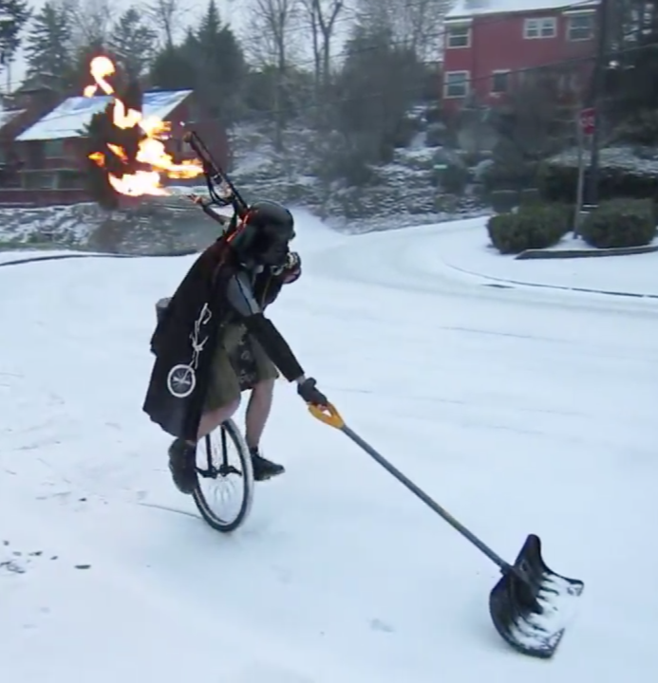
Risk Management
Weather
Mobility on site
Stinging insects
Dangerous objects
People/Animals
Our #1 priority is safety!
Notes:
Flooding, needles

Slide 34
NEXT STEPS
Tonight:
7:30-8:00 Natural Area Sign-up, wrap up, hand in paperwork.

Slide 35
THANK YOU!!!
Notes:
Thank you all so very much for contributing your positive energy towards this watershed and the community. You make our restoration work happen!

